Slide 1

ANZ Dataset EDA
Mehmet Ozer

Slide 2
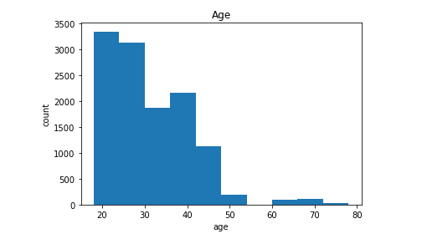
Age histogram of customers' ages

Slide 3
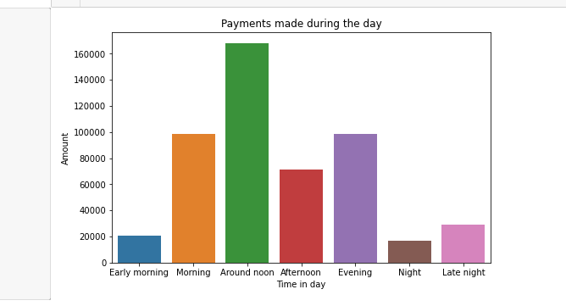
Payments made by customers by time in a day

Slide 4
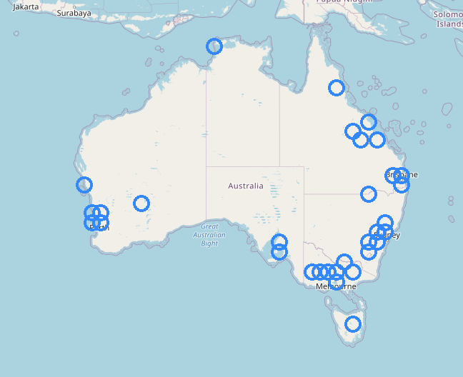
Payments made by customers by Location

Slide 5
Thank you

